Slide 1
Induction & Augmentation Of Labor

Slide 2
Outline
Introduction
Define induction & augmentation of labor
Identify indications & contraindications of induction of labor
List preconditions for induction of labor
Discourse about preinduction cervical ripening
Discuss methods of labor induction & augmentation
Describe complications of induction

Slide 3
Introduction
Induction and augmentation of labor are among the most commonly performed obstetric procedures.
In modern obstetrics, several pharmacological agents permit labor to be induced or augmented.
Over the past several decades, the incidence of labour induction for shortening the duration of pregnancy has continued to rise.

Slide 4
Cont…
Incidence: varies between countries
USA: increased more than 2X from 9.6%(1990) to 23.8%(2010), 27% (2019)
UK: 30%
Low- and Middle- income countries:
Generally lower, but in some settings, it can be as high as those observed in high-income countries (~25%).

Slide 5
Definition
Induction of labor:- artificial stimulation of uterine contractions before the onset of spontaneous labor to accomplish vaginal delivery.
Augmentation of labor:- enhancement of the frequency and intensity of existing spontaneous uterine contractions that are considered inadequate to accomplish vaginal delivery.

Slide 6
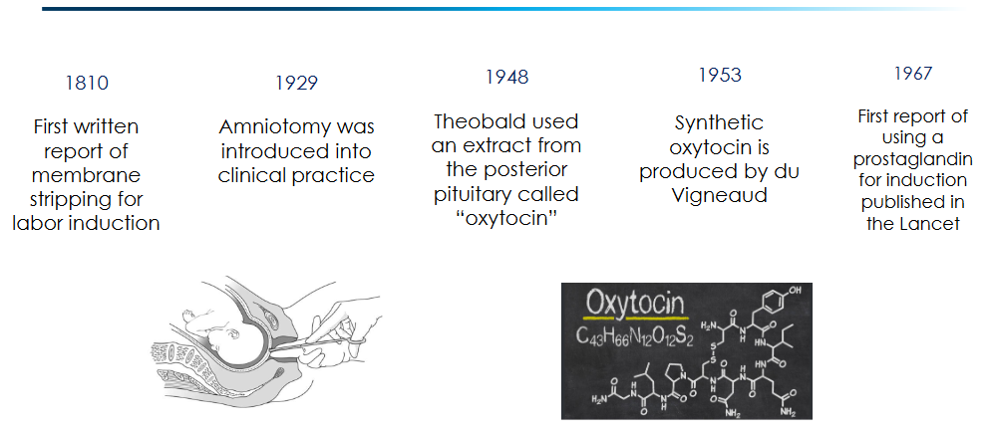
History of Induction of Labor

Slide 7
Induction Of Labor
Can be classified into:-
Elective :- initiation of labor for convenience in an individual with a term pregnancy who is free of medical or obstetric indications.
Performed for the convenience of the patient or the professional staff
Generally, it is not recommended or encouraged.
Emergency (Indicated) :- performed for maternal or fetal medical or obstetric complications.

Slide 8
Indications For Induction Of Labor
Obstetric conditions
Post-term pregnancy
Premature rupture of membranes
Chorioamnionitis
Abruptio placentae
Hypertensive disorders of pregnancy
GHTN - Preeclampsia - Eclampsia Syndrome

Slide 9
Cont…
Maternal medical conditions
Diabetes mellitus
Chronic hypertension
Renal disease
Chronic pulmonary disease
Cardiac disease
Fetal conditions
Fetal growth restriction
Isoimmunization
Non reassuring antepartum fetal testing
Oligohydramnios
IUFD

Slide 10
Contraindications For Induction Of Labor
Absolute Contraindications
Contracted pelvis
Invasive cervical cancer or any Tumor Previa
Active genital herpes infection
Prior uterine rupture
Previous uterine incision that would preclude a trial of labor
Placenta previa or vasa previa
Umbilical cord prolapse
Abnormal lie
Malpresentations
Category III fetal heart rate tracing

Slide 11
Cont…
Relative Contraindications
Fetal macrosomia
Breech presentation (if footling - absolute cont.)
Twin pregnancy (if >2 - absolute cont.)
Inability to adequately monitor the fetal heart rate throughout labor
Prior LUST C/S (if >1 - absolute cont.)
Suspected CPD
Grand multiparity (≥ 6 births)

Slide 12
Preconditions For Induction Of Labor
Induction of labor should be undertaken when the benefits of delivery to either mother or fetus outweigh the risks of pregnancy continuation.
Induction of labor interventions incur maternal and fetal risks. So, should be performed after getting informed maternal consent.

Slide 13
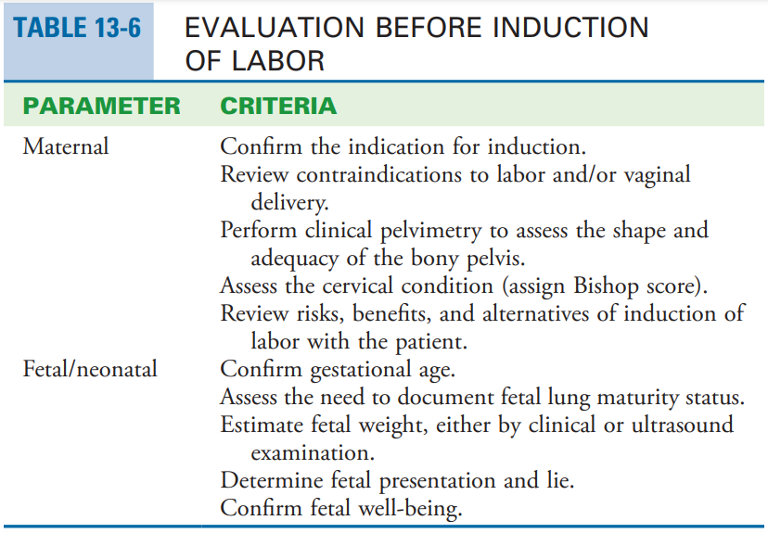
Cont…
Get informed consent
Document the indication
Make sure that there are no contraindications
Assess the cervix (Determine Bishop score)
Ascertain availability of labor ward staff and also the capacity to do emergency caesarean section
1

Slide 14
Cont…
Cervical status is one of the most important factors for predicting the likelihood of success in induction of labor.
A soft cervix; described as “ripe” or “favorable” is important to successful labor induction.
One quantifiable method to predict labor induction outcomes is the score described by Bishop (1964).

Slide 15
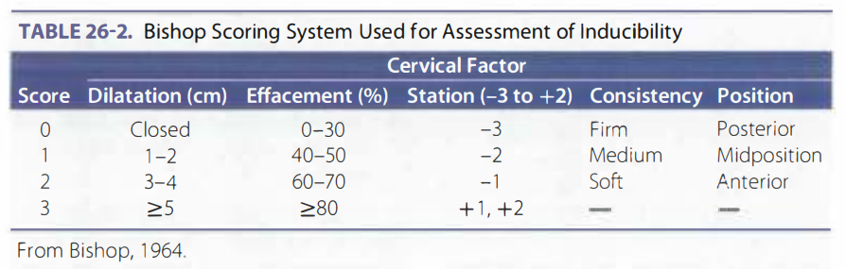
2
The total cervix score is obtained by adding the points scored for each factor

Slide 16
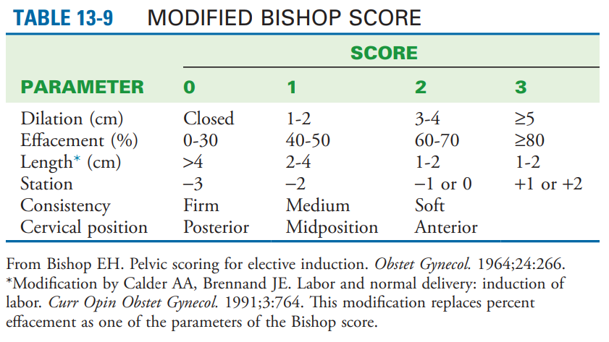
The total cervix score is obtained by adding the points scored for each factor
3

Slide 17
Bishop Score Cont…
As favorability or Bishop score increases, the rate of induction to effect vaginal delivery also increases.
A Bishop score of 9 conveys a high likelihood for a successful induction.
Score < 6 ➔unfavorable
Score - 6-8 ➔intermediate
Score of ≥9 ➔favorable

Slide 18
Preinduction Cervical Ripening
A complex process that results in physical softening and distensibility of the cervix.
Pharmacological and mechanical methods are used.
Goal:
To facilitate the process of cervical softening, thinning, and dilatation
To shorten the induction to delivery time and to decrease the rate of failed induction

Slide 19
Cervical Ripening Methods
Mechanical methods
Osmotic/hygroscopic dilators
Laminaria tents
Dilapan-S
Foley catheters (14 - 26 F) with inflation volume of 30–80 ml
Double balloon devices
Extra-amniotic saline infusion
Membrane stripping

Slide 20
Cont…
Pharmacological methods
Prostaglandin E1 (PGE1 ): Misoprostol
Prostaglandin E2 (PGE2 ): Dinoprostone - tablet, gel or pessary /insert

Slide 21
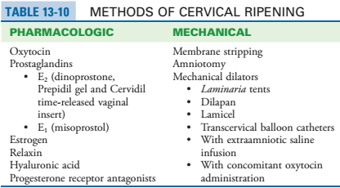
4

Slide 22
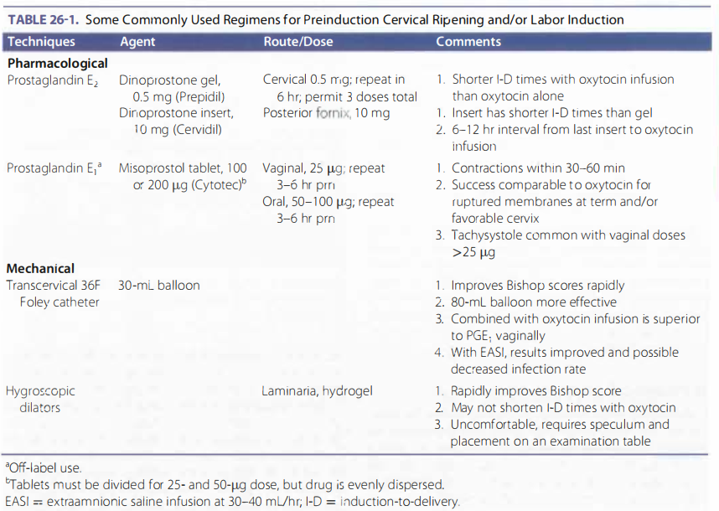
5

Slide 23
Mechanical Methods
Mechanisms
Release of prostaglandin F2-alpha from the decidua and adjacent membranes or PGE2 from the cervix.
Physically cause gradual cervical dilation with minimal discomfort to the patient.
Laminaria
Balloon catheter

Slide 24
Cont…
Advantages
Low cost
Low risk of tachysystole
Few systemic side effects
Disadvantages
?Risk of infection (rarely)
Disruption of a low-lying placenta (rarely)
Maternal discomfort (Manipulation)

Slide 25
Membrane Stripping/sweeping
Digital separation of the chorioamniotic membrane from the wall of the cervix and lower uterine segment
Significantly increases in phospholipase A2 activity and prostaglandin F2α (PGF 2α) levels
Increases the likelihood of spontaneous labor within 48 hours
Reduces the incidence of induction with other methods, and also shortens the induction to delivery interval

Slide 26
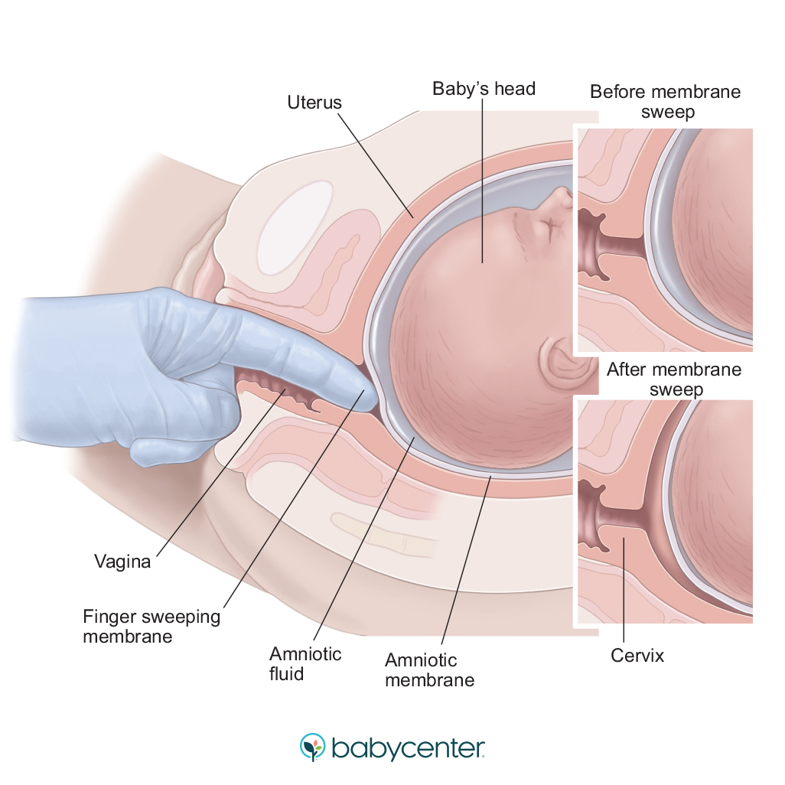

Slide 27
Transcervical balloon catheter – Foley Catheter Placement
With or without extra amnionic saline infusion
Appears to be as effective for preinduction cervical ripening as PGE2 gel and intravaginal Misoprostol
Insert No 16 or 18 into the cervix above internal os digitally or using speculum, aseptic technique should be followed
Instill 30- 80 ml NS.

Slide 28
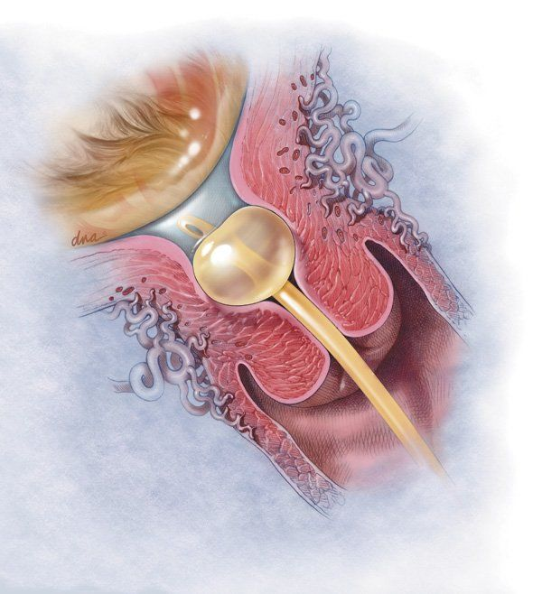
Cont…
Pull gently to the level of internal cervical os.
Apply light traction to the catheter.
Leave for 12hrs or till spontaneously expels.

Slide 29
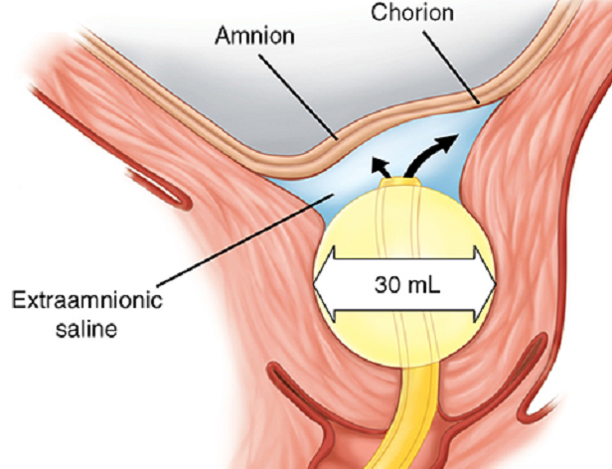
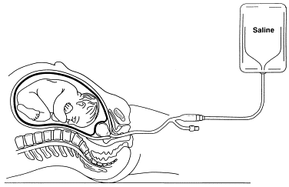
Extra amnionic saline infusion (EASI)
A constant saline infusion through the catheter with infusion rate of 30–40 ml/h in to the space between the internal os and placental membranes
One modification of foley catheter placement

Slide 30
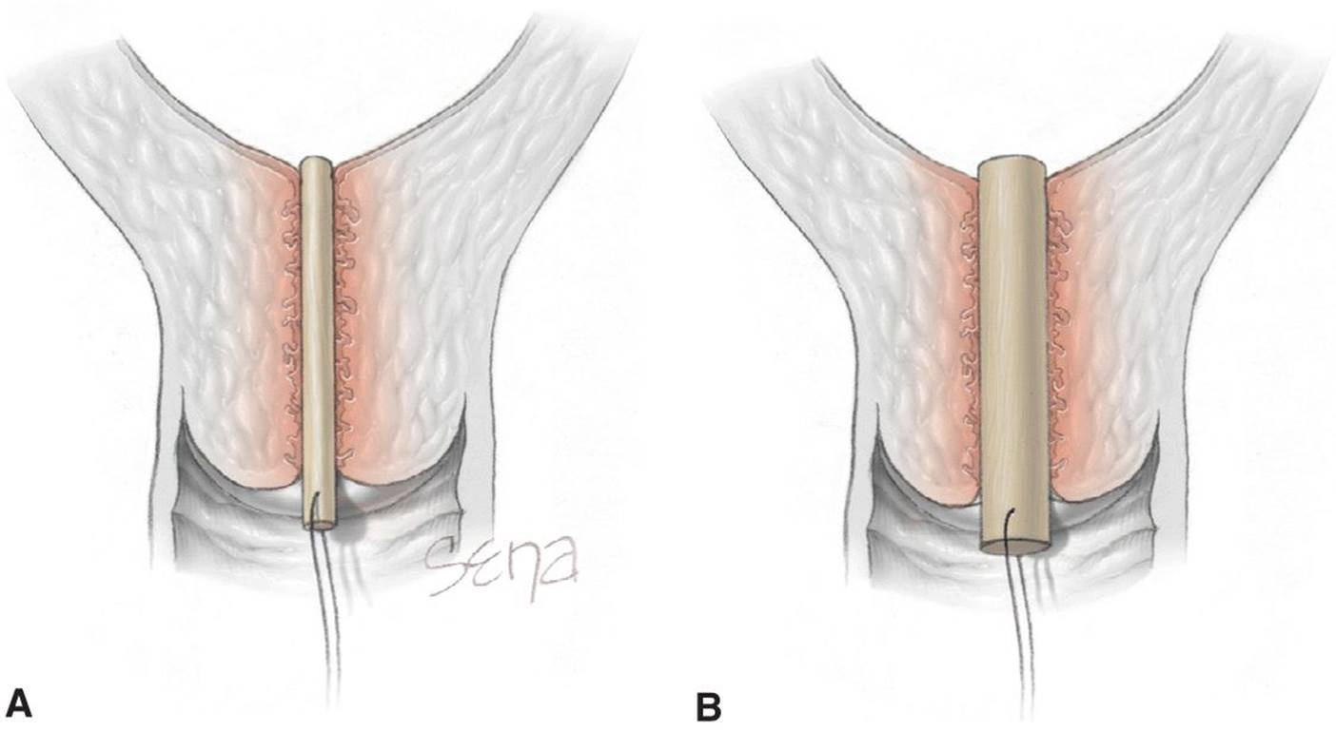
Hygroscopic Cervical Dilators
Osmotic cervical dilators
hydrophilic agents that absorb water and thus gradually expand within the cervical canal, which in turn causes the cervix to dilate
Include Laminaria japonicum or hygroscopic devices (Dilapan-S)
Laminaria

Slide 31
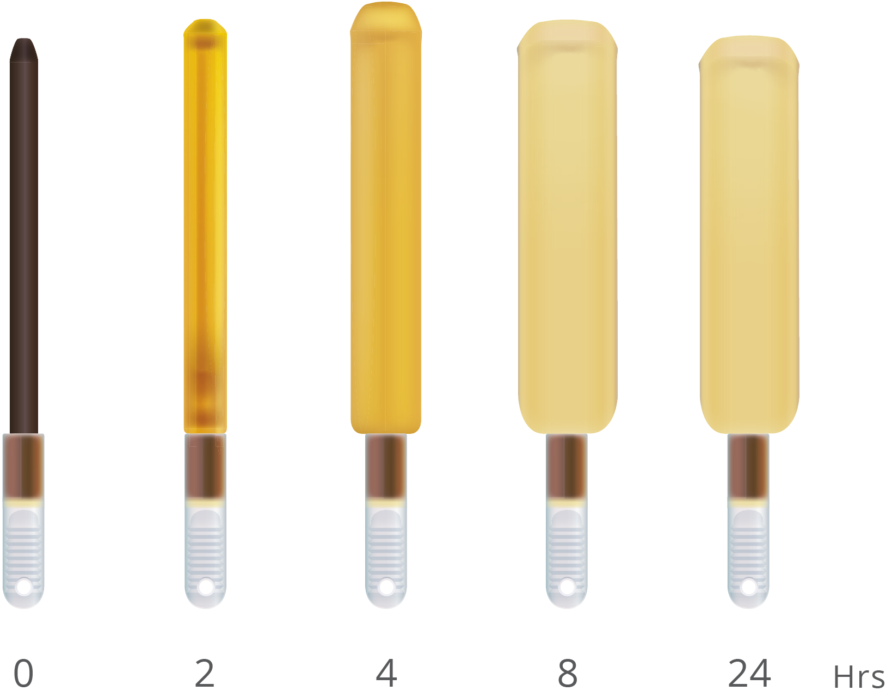
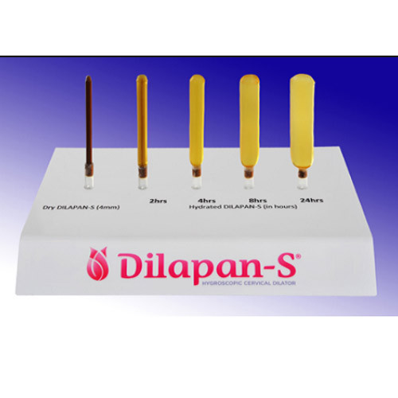
Cont…
Laminaria: overnight preparation offers optimal cervical dilation
Dilapan-S: preferable for same-day procedures, maximal effect in 4 - 6 hrs

Slide 32
Pharmacologic Methods
PG formulations have been used since they were first synthesized in the laboratory in 1968.
Administration of PG results in dissolution of collagen bundles and an increase in submucosal water content of the cervix.
PGs can also stimulate contractions and thereby aid subsequent labor induction or augmentation.
PG formulations of any kind should be avoided in women with a prior uterine scar

Slide 33
Prostaglandin E1 (Misoprostol)
Misoprostol - Cytotec - is a synthetic PGE1 analogue available as 25-µg, 100-µg and 200-µg tablets.
Inexpensive and is also stable at room temperature
Administered orally or placed vaginally
buccal and sublingual routes are possible options
Vaginal (place into the posterior fornix): 25 mcg (only if misoprostol is available in the form of a 25-mcg tablet), if required repeat after 6 hours.

Slide 34
Cont…
Oral: 25 mcg; if required repeat after 3 hours.
If 25 mcg is not available, dissolve one 200 mcg tablet in 200 mL of water and administer 25 mL of that solution as a single dose.
If 12 hours have passed since the first dose of misoprostol, discontinue misoprostol and begin oxytocin infusion.
Or 4 hours after the final misoprostol dose

Slide 35
Prostaglandin E2 (Dinoprostone)
Local application of PGE2 (Dinoprostone)
Preparations
Prepidil (intracervical gel)
0.5 mg of Dinoprostone gel in 2.5 ml syringe
repeated every 6 hrs, with a max of 3 doses in 24 hrs
Crevidil (intravaginal insert)
a 10 mg of dinoprostone vaginal insert in a timed-release formulation
the insert provides slower release of medication-0.3 mg /hr
used as a single dose & removed after 12 hrs or with labor onset
3 mg pessary - placed high in the posterior fornix of the vagina and may be repeated after six hours if required.

Slide 36
Cont…
After administration:
-Continuous uterine activity & FHR monitoring.
-Remain recumbent for at least 30 min.
-Observation for 30 min - 2hrs.
-Contraction occurs:
→in the first hour and show peak in the first 4hrs
→FHR and V/S recording
Oxytocin induction should be delayed for 6 - 12 hrs or for at least 30 mins after removal of the vaginal insert.

Slide 37
Cont…
Side effects
Uterine tachysystole
>5 contraction in 10 min for a total of 20 min)
Usually begins within 1 hr
Management - Remove vaginal insert but irrigation of cervix, vagina: not helpful
Systemic effects:
Nausea, vomiting, diarrhea, glaucoma, hepatic and renal disease, asthma.

Slide 38
Methods Of Labor Induction
Medical Induction Methods
Oxytocin
Prostaglandin E1 analogues (Misoprostol)
Prostaglandin E2 analogues (Dinoprostone)
“Surgical Induction” Methods
Membrane stripping
Amniotomy
Other Methods
?Nipple stimulation
Foley catheter method

Slide 39
Oxytocin
A polypeptide hormone produced in the hypothalamus and secreted from the posterior lobe of the pituitary gland in a pulsatile fashion
It is identical to its synthetic analogue
The plasma half-life estimated at 3 - 6 mins, and steady-state concentrations are reached within 30 - 40 mins of initiation or dose change

Slide 40
Cont…
Cannot be given orally because the polypeptide is degraded to small, inactive forms by GI enzymes.
Response and the maximal effective dose of oxytocin to achieve adequate uterine contraction in all women is different
Preexisting uterine activity
Cervical status
Pregnancy duration
Individual Biological Differences

Slide 41
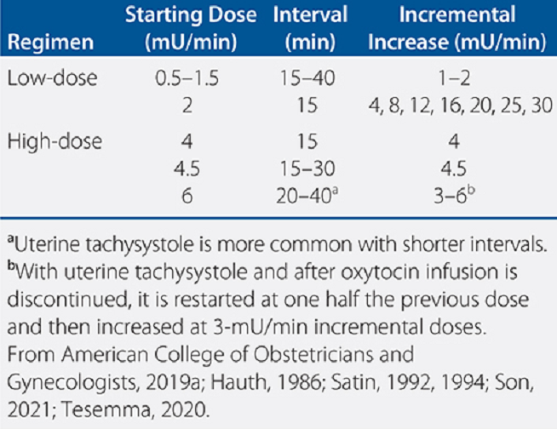
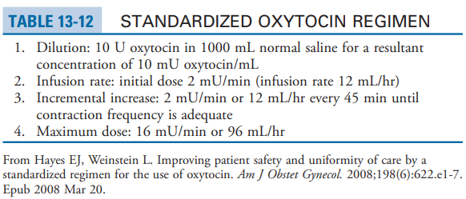
Various protocols of high-dose (4 to 6 mU/min) and low-dose (0.5 to 1.5 mU/min) oxytocin regimens
1 ml vial contains 10 U of oxytocin (Standard)
TABLE 6
7

Slide 42
Oxytocin Infusion (FMOH 2020)
Use 0.9% N/S or R/L for infusion.
The initial infusion rate should be set at 1-2mu/min
The infusion rate is increased every 30 mins up to a maximum of 40 mu/ min (250 ml/hour)
Alternative, oxytocin with starting dose of 3-6mu/m can be used. (for induction of a primigravid only)

Slide 43
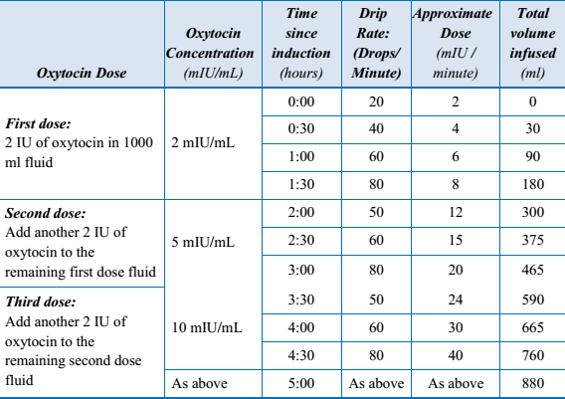
Oxytocin infusion rates for induction of labor. FMOH 2020

Slide 44
Amniotomy - ARM
A procedure involving puncturing the fetal membranes and releasing the amniotic fluid
Was the cornerstone of labor induction before effective pharmacological agent became available
Especially if the condition of the cervix is favorable
Risks: unpredictable and sometimes long intervals before the onset of contractions; cord prolapse, IAI and rarely Placental abruption

Slide 45
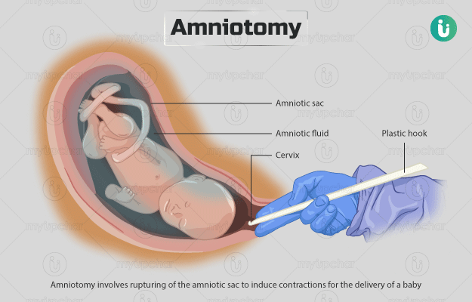
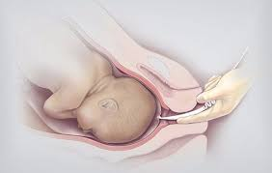
Insufficient evidence on the efficacy and safety

Slide 46
Complications of Labor Induction
Maternal
Failed induction
Increased risk of cesarean delivery
Uterine tachysystole / Tetanic C.
Atonic PPH
Amniotic fluid embolism
Water intoxication & hyponatremia
Fetal
Fetal distress
Iatrogenic prematurity
Neonatal sepsis
Cord prolapse
For Both
Uterine rupture
Placental abruption
Chorioamnionitis
Precipitated labor

Slide 47
Uterine Tachysystole
> 5C/10 min &/or Contraction lasting >=60 Sec
Management
Stop the infusion, put the woman on left lateral position and assess the FHR
After observation and monitoring, if both the mother and fetus are in good condition, restart at half dose of the last dose causing uterine hyper stimulation.
If not, manage accordingly

Slide 48
Failed Induction
Failure to achieve regular uterine contractions and cervical change after at least 6 - 8 hours of the maintenance dose of oxytocin administration, with artificial rupture of membranes if feasible - FMOH 2020
If the maternal and fetal status allow, cesarean deliveries for failed induction of labor in the latent phase can be avoided by allowing longer durations of the latent phase (up to 24 hours or longer) and requiring that oxytocin be administered for at least 12–18 hours after membrane rupture before deeming the induction a failure - ACOG

Slide 49
Augmentation of Labor
Augmentation of labor:
Enhancement of the frequency and intensity of existing spontaneous uterine contractions that are considered inadequate because of failed cervical dilation and poor fetal descent to accomplish vaginal delivery.

Slide 50
Cont…
Indication: a weak and ineffective uterine contractions leading to abnormal progress of labor.
Contraindications:
Breech presentation
Scarred uterus
Multiple pregnancy
Feature of CPD
Secondary hypotonic contractions due to obstructed labor etc...

Slide 51
Methods Of Augmentation
ARM
Oxytocin
The procedure is generally similar to that of induction
If there is no urgency to expedite delivery, oxytocin infusion is initiated one hour after ARM and if the ARM failed to correct the weak contractions

Slide 52
Artificial Rupture of Membranes (ARM)
ARM is a recommended practice in both induction and augmentation.
Prerequisites
− Appropriate indication
− Engaged fetal head (relative)
− No contraindications such as cord presentation, vasa previa, infection
− No fetal distress (unless immediate vaginal delivery is possible)

Slide 53
Oxytocin for Augmentation of Labor
Oxytocin is the only medication approved by the US FDA for labor stimulation in the active phase.
Either a high or low dose oxytocin regimen is acceptable.
Higher dose regimens are associated with shorter labor and fewer cesareans, but more tachysystole.

Slide 54
Summary
Induction of labor is one of the most commonly performed procedures in obstetrics
A variety of pharmacologic and mechanical methods for cervical ripening are available
Avoid elective inductions in nulliparous with unfavorable cervix
The most frequently encountered complication of oxytocin or prostaglandin administration is uterine overactivity.
Prostaglandins should not be used in scarred uterus

Slide 55
Q & A.
Discussions

Slide 56
THANK YOU!

